Slide 1
RUNGTA COLLEGE OF DENTAL SCIENCES & RESEARCH
CELLULITIS
DEPARTMENT OF GENERAL SURGERY

Slide 2
Specific learning Objectives
At the end of this presentation the learner is expected to know ;
Core areas* | Domain ** | Category #
Cellulitis | Cognitive | Must Know
Erysipelas | Cognitive | Must Know
Ludwig's Angina | Cognitive | Must Know
Boil | Cognitive | Must Know
Carbuncle | Cognitive | Must Know
Necrotizing Fasciitis | Cognitive | Must Know

Slide 3
Table of Content
Erysipelas
Ludwig's Angina
Boil
Carbuncle
Necrotizing Fasciitis

Slide 4
CELLULITIS
It is a spreading subcutaneous inflammation.
Causetive agent-Haemolytic streptococcus.
Bacteria produces two enzymes-
1.Hyaluronidase
2.Streptokinase

Slide 5
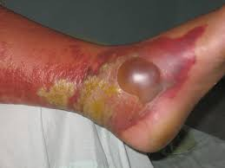
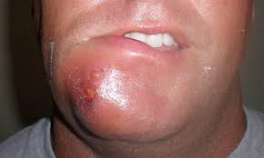

Slide 6
Common sites- Face
Scrotum
Fore arm & leg
Sources of infection(due to break in skin barrier)
Injuries-minor or major
Scratches on skin
Insect ,scorpion or snake bite.
Pre-disposing factors-
Diabetes,Malnourished,Low immunity.

Slide 7
Clinical features-
Affected part - diffuse swelling
-redness & shiny
-painful & itching
Systematically- fever
pain
May develop toxaemia.
In untreated cases-Suppuration,sloughing
and gangrene may occur.

Slide 8
Treatment-
1.Bed rest and part is elevated.
2.Glycerin magsulf dressing
3.Diabetes control
4.Appropiate antibiotic-
Inj. Crys.penicillin 10 lakh unit 6hrly5-7day
or Ciprofloxicin 500 mg twice a day.
5.Anti-snake venom in snake bite cases.

Slide 9
Complication-
1.Suppuration and abscess formation.
2.Necrotising fascitis
3.Toxaemia and septicaemia.
4.Ketoacidosis in diabetes.
*********

Slide 10
ERYSIPELAS
It is an acute infection of upper dermis of skin and superficial lymphatics caused by beta- haemolytic group of streptococci.
It is more superficial than cellulitis. Surface is raised and well demarked.

Slide 11
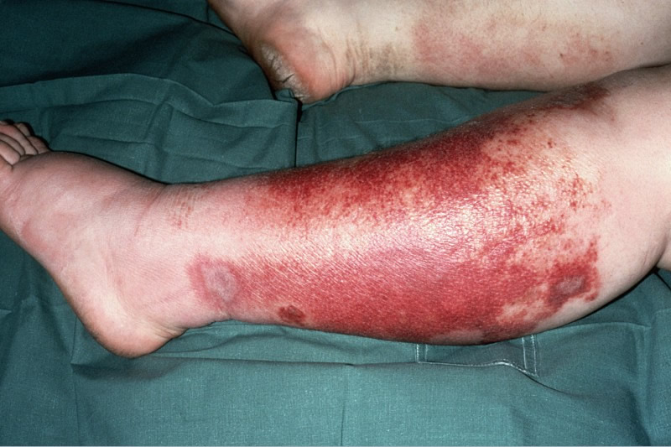
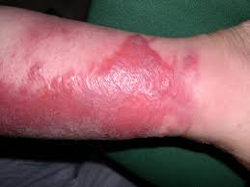

Slide 12
Precipitating factors-
* malnourishment,
* Chronic diseases,
* Children & old people
Onset- After a small scratch or abraison, it
spreads quickly resulting in toxaemia.
Common sites- Face,
eyelids,
forearm,
scrotum.

Slide 13
Clinical features-
1.Rose pink rashes with raised edges having
consistency of button hole.
2.Vesicles appear later,rarely pustular.
3. Oedema and toxaemia may be seen.
4. Milian’s ear sign is positive.
Complication-
1.Toxaemia and septicaemia
2.Gangrene of skin and subcuteneous Tissue.
3. Lymphodema of face and eyelid due to
obstruction to lymphatic drainage.
Treatment-1.Appropriate antibiotic
-2.Symptomatic trt. For aches & fever
3.Saline wet dressing
4.Elevation of limb and rest to the part.
5.Hydration by IV infusion
6.Careful monitoring of patient.

Slide 14
LUDWIG’ ANGINA
DEFINITION- It is an acute inflammation of
submental and sub mandibular region
associated with oedema of floor of the
mouth.
Agent- Virulent streptococcal organism
-Anaerobic organism.
Precipitating factors-
1.Caries tooth
2.Cachexia
3.Chronic diseases-(diabetes)
4.Calculi in submandibular gland
5.Cancer of the oral cavity
6.Chemotherapy.

Slide 15
Clinical features-
* Diffuse swelling in submental and
submandibular region with brawny
oedema.
* Oedema of the floor of the mouth which
pushes tounge upwards causing difficulty
swallowing.
* Putrid halitosis
* High grade fever with toxicity.

Slide 16
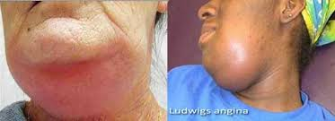

Slide 17
MANAGEMENT-
It is a serious condition and timely care and treatment is essential.
Hospitalisation
Intravenous infusion and correction of
dehydration.
In some cases,Ryle’s tube feeding and oxygen
may be required.
Antibiotic-broad spetrum
Oral hygiene to be improved.
Treatment of the associated co-morbidity
Surgery- *Under general anaesthesia
* 5-6 cm curved incision below mandible
* Submandibular gland is mobilised,
*Mylohyod muscle is divided and pus is drained.
* Wound is closed with loose sutures after irrigation.
*A drainage tube is kept in place.

Slide 19
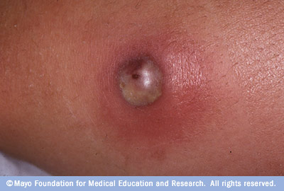
BOIL

Slide 20
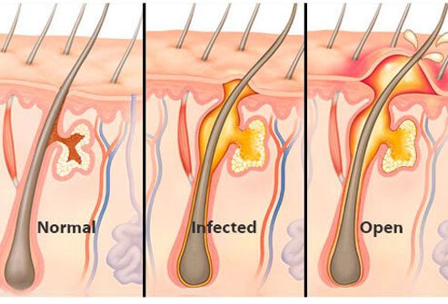

Slide 21
It is an hair follicle infection usually secondary to sebaceous gland infection.
Causative agent- Staphylococcus aureus
Clinical features-
Swelling indurated,painful
oedema and redness,
After 1-2 days, it softens and thereafter it burst spontaneous.
Pus comes out as discharge.

Slide 22
Some interesting facts about boil-
1.Most painful boil- external meatus
2.Most dangerous boil- dangerous area of face
3.Sweet boil- seen in diabetic patient
4.Dull boil- no suppuration
5.Boil like- oily skin

Slide 23
DANGEROUS AREA OF FACE

Slide 24
COMPLICATIONS
Necrosis of skin
2.Septicaemia and toxemia
3.Cavernous sinus thrombosis
4. Meningitis or brain abscess.
***

Slide 25
TREATMENT
Incision and drainage with excision of slough.
Suitable antibiotics and analgesics/antipyratics.
***

Slide 26
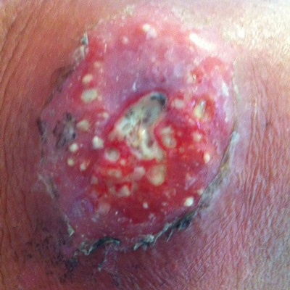
CARBUNCLE

Slide 27
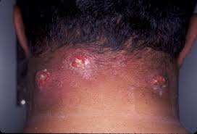

Slide 28
It is a infectious gangrene of skin and subcutaneous tissue. “It is cluster of boils.”
Causative agent: staphylococcus aureus
Predisposing factor:
Diabetic patient
Obese
Poor and malnourished people
People with poor immunity

Slide 29
Common site :
Nape of neck.
Back.
Shoulder region.
Places where friction of hair occur due to clothing or furniture .

Slide 30
Pathology:
Starts as folliculitis
Perifolliculitis
Necrosis of subcutanious tissue and fat
Multiple abscess formation intercommunicating
Open exterior and discharge pus
Multiple pus discharging opening give sieve like opening.

Slide 31
Clinical feature:
Severe pain and swelling of part.
Multiple pus discharge opening cribriform appearance.
Surface is red,angry looking.
Surrounding indurated .
Crateriform ulcerformation.
Fever.
Bodyache.
Malaise.

Slide 32
Complications:
Extensive necrosis of overlying skin.
Septicaemia and toxaemia.
Worsening of diabetic status.

Slide 33
Treatment:
General treatment:
Surgical treatment:
Controlling diabetes
Antibiotics after pus culture
MRSA: vancomycin
i.v infusion if required
Analgesic and Antipyretic
Surgery is required when there is pus
Cruciate excision is given
All septas are broken

Slide 34
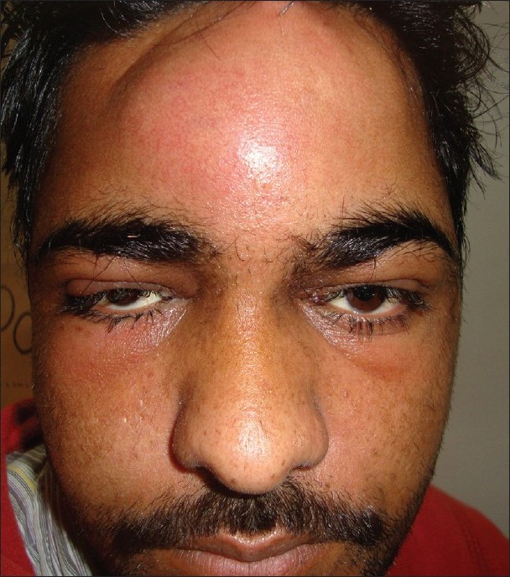
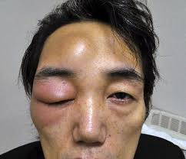
POTT’S PUFFY TUMOUR
It is the formation of diffuse external swelling in scalp due to subperiosteal pus formation and scalp oedema.

Slide 35
CAUSES
Frontal sinusitis which suppurates and extend to subperiosteal region.
2. Trauma causing frontal haematoma.
3. Chronic otitis media.

Slide 36
CLINICAL FEATURES
1.pain,swelling
2.tender,warm
3. Toxic look ,drowsiness.
COMPLICATIONS
Osteomylitis of frontal bone.
2. Spread of infection into the cranial cavity,extra dural and subdural abscess.

Slide 37
Investigation
CBC
ESR
X-RAY
CT-SCAN
Treatment-
1.Under antibiotic coverage drainage of pus under GA.
2. Infection entering to cranial cavity- treated according to surgery.
3. osteomylitis of frontal bone may need radical removal and reconstruction.
***

Slide 38
NECROTISING FASCITIS
It is also known as flesh eating disease.
It is a very serious disease.
It is a fast spreading ,destructive and invasive infection of skin and soft tissue involving deep fascia too but rarely involves skeletal muscles.

Slide 39
Common sites-
*Genitalia
* Lower abdomen
* Perineum
* Limbs
Types- * Mono-microbial or(Type-2 necrotising
-fascitis)caused by group A beta haemolytic
streptococci.
* Poly-microbial or (type-1 Necrotising fascitis ) It is
due to synergistic combination of multiple
bacterial infection including non-group A haemolytic
streptococci and anaerobes.

Slide 40
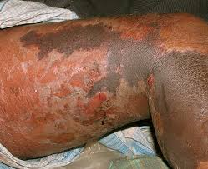
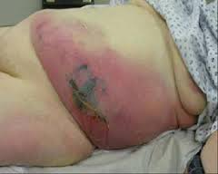

Slide 41
Clinical features-
* sudden pain and swelling of affected part.
* Red and oedematous skin.
* Skip lesion of necrosis and ulcerations.
* High fever,signs of toxaemia and septica-
-emia and may have jaundice,renal failure.
Diagnosis-
* Full thickness biopsy
* Watery discharge(dishwater liquid) is chara-
-cteristic.

Slide 42
Treatment-
1.Hospitalisation
2.Adequate hydration
3.Broad spectrum antibiotic
Surgery-Wide excision,generous debri-
-dement followed by skin graft
after few days.
Note- In type 2 necrotising fascitis-high dose of penicillin along with CLINDAMYCIN is treatment of choice.Clindamycin prevents synthesis of toxins.
********

Slide 43
REFERENCES
SRBS BOOK OF GENERAL SURGERY
A MANUAL ON CLINICAL SURGERY - S DAS
MANIPAL MANUAL OF SURGERY - K RAJGOPAL SHENOY
BAILEY AND LOVES SHORT PRACTICE OF SURGERY

Slide 44
Question & Answer Session
You may ask your doubts related to the topic?

Slide 45
THANK YOU

